Slide 1
SACT
Principles of Safe Practice
2019

Slide 2
Contents
What is SACT?
Risks of SACT
Principles of safe practice
NCEPOD recommendations
Prescribing
Types of SACT
Chemotherapy
Chemotherapy toxicities
Chemotherapy – clinical verification (screening) considerations
Targeted therapies
Oral targeted therapies
Oral targeted therapies – clinical verification (screening) considerations
Monoclonal antibodies – clinical verification (screening) considerations
Immunotherapy
Immunotherapy toxicities (irAE)
Immunotherapy – clinical verification (screening) considerations
SACT clinical verification (screening) considerations – general points to consider
Cancer Drug Funding (NHS England)
Forms
Final checking and release
Patient information – safe practice
Resources

Slide 3
What is SACT?
Systemic Anti-Cancer Therapy
All chemotherapy and targeted agents used for the treatment of cancer
Does not include:
Hormonal treatments, e.g. bicalutamide, anastrozole
Exception: abiraterone and enzalutamide are included
Non-cancer indications

Slide 4
Risks of SACT
High risk of errors if non-accredited staff involved
Not following established protocols
Perception that oral SACT not as toxic as IV SACT
Incomplete or illegible prescriptions
Incorrect dosing or modification
Incorrect labelling and dispensing
Patient not fully informed of how to take (orals) or how to manage side effects

Slide 5
Principles of safe practice
Manual of Cancer Service Standards (2004)
Cancer patients under specialist care
Trust chemotherapy policies for IV and oral chemotherapy
Formal risk assessments
Oral chemotherapy prescribed and dispensed to same standards as IV
Patient education and counselling
STANDARD
All cytotoxic chemotherapy prescriptions should be checked and authorised by a pharmacist.
Manual for Cancer Services: Department of Health 2004 3C-2091
BOPA position statement (2004) (Principles of Safe Practice)
BOPA Standards for Pharmacy verification of prescriptions for Cancer Medicines, Third Edition October 2018
Notes:
Needs updating?

Slide 6
NCEPOD recommendations
All SACT prescriptions should be checked by a pharmacist who has undergone specialist training, demonstrated their competence and is locally authorised/accredited for the task. This applies to oral as well as parenteral treatments
Pharmacists should sign (can be electronic) the SACT prescription to indicate that it has been verified and validated for the intended patient and that all the safety checks have been undertaken

Slide 7
Prescribing
Within MDT recommendations
Within context of written protocols
Treatment plan documented in notes including criteria for stopping/modifying treatment
Electronic systems designed for the purpose of prescribing SACT to be used
Intended deviations from protocol clearly identified and Trust’s off-protocol procedure followed
Prescriber must be on the SACT prescribing register

Slide 8
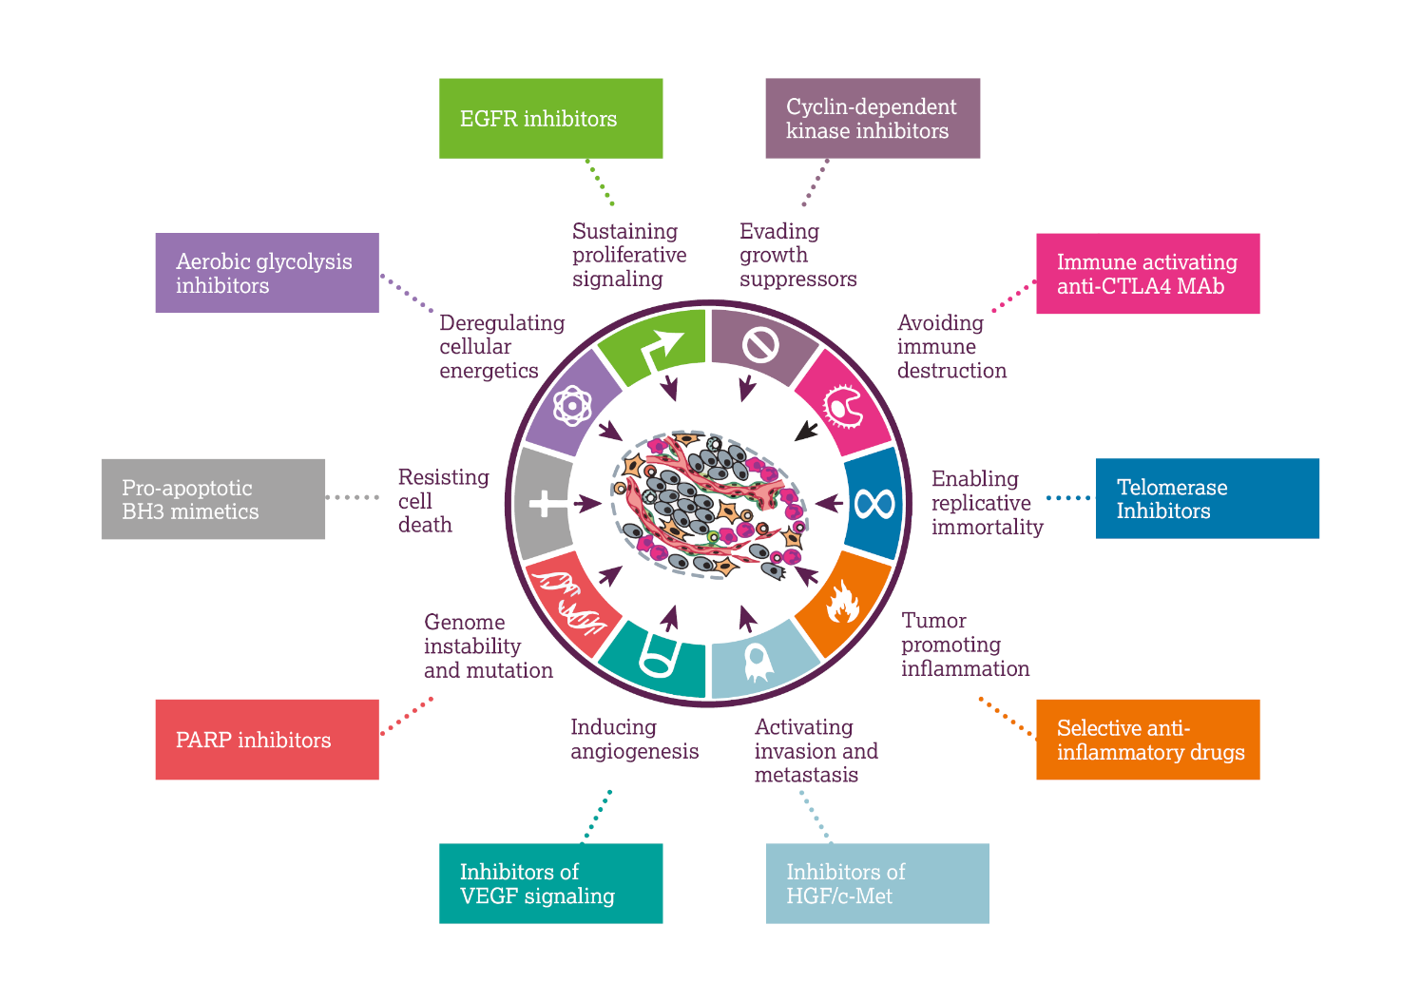
Types of SACT
Chemotherapy
Hormonal therapy
Targeted therapy
Immunotherapy
Advanced Therapy Medicinal Products (ATMPs)
Based on a diagram from Hanahan, D., & Weinberg, R. A. (2011). Hallmarks of cancer: the next generation. Cell, 144(5), 646-674.

Slide 9
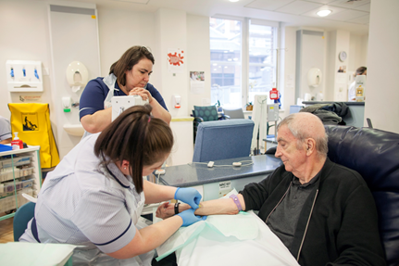
Chemotherapy
Treatment of cancer with the use of cytotoxic drugs
Monotherapy or Combination
Systemic e.g. IV, IM, SC, oral
Regional e.g. intrathecal, intra-arterial, intra-vesical
Intent
Curative – aggressive treatment
Neoadjuvant – given before surgery to decrease tumour size
Adjuvant – given after surgery or with radiotherapy to ‘mop up’ any cancer cells
Palliative – given to prolong life (months), reduce symptoms
Course or continuous
Examples FEC, CHOP, ECX
Photo courtesy of The Royal Marsden

Slide 10
Chemotherapy toxicities
General
Myelosuppression
Anaemia, neutropenia, thrombocytopenia
GCSF where appropriate
Blood products
Nausea and vomiting
Appropriate antiemetic prophylaxis
Alopecia
Cool cap
Fatigue
Specific
Renal (platinums), hepatic, skin/nail (taxanes), diarrhoea (fluorpyrimidines/irinotecan)
REFER TO LOCAL GUIDELINES FOR MANAGEMENT

Slide 11
Chemotherapy – clinical verification (screening) considerations
Indication
Funding/payment of treatment
Dosing – BSA, weight, flat dose, AUC?
Interval
Cycle number (course versus continuous)
Cumulative dose?
Kidney, liver, cardiac function (as appropriate)
Toxicities from previous treatment
Allergies, co-morbidities, interactions with concurrent medication
Supportive medication

Slide 12
Targeted therapies
Reprinted by permission from the Licensor: Springer Nature. Wadhwa, R. et al. (2013) Gastric cancer: molecular and clinical dimensions. Nat. Rev. Clin. Oncol. 10(11):643-55 doi:10.1038/nrclinonc.2013.170
Notes:
Overview slide to explain complexity only – more detail regarding types of targeted therapy after this

Slide 13
Oral targeted therapies
Tyrosine kinase inhibitors, MEK inhibitors, PARP inhibitors
Continuous or intermittent
Monotherapy or combination
Histology needed
ALK, EGFR, T790M, BRAF, BcrAbl etc
Different range of toxicities
Hypertension, skin rash, thyroid dysfunction, proteinuria (refer to local guidelines for management)
Patients should be counselled by a nurse/pharmacist before initiation of oral SACT
Given written information
Given emergency contact details

Slide 14
Oral targeted therapies – clinical verification (screening) considerations
Funding/indication
Interval – continuous versus intermittent
Surplus supply – due to:
Pack size (30 days supply every 4 weeks)
Poor adherence – barriers?
Previous toxicities
Additional monitoring (drug specific)
ECG
TFTs
Urine dip
Creatine Kinase
Assessment of disease response
Routine scans
Clinical review

Slide 15
Monoclonal antibodies – clinical verification (screening) considerations
Indication/funding
IV or SC
Used alone or in combination with another MAb +/- chemotherapy
Interval
Re-loading?
Continuous versus fixed course length depending on treatment intent
Adjuvant
Maintenance
Metastatic
Can affect cardiac function
Routine ECHOs required

Slide 16
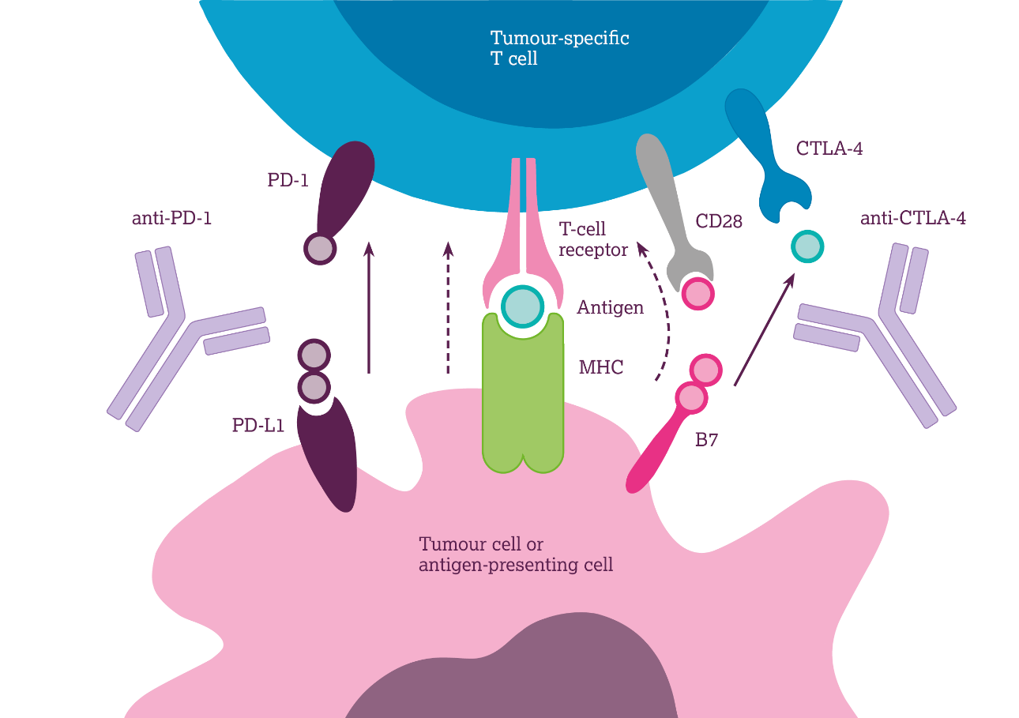
Immunotherapy
Rapidly growing area in cancer management
Targets include PD-1,CTLA-4
Acts by ‘waking up’ the body’s own immune system
Includes pembrolizumab, nivolumab, ipilimumab, atezolizumab and more
Approved for use in many tumour types – constantly increasing
Different toxicities to conventional chemotherapy
Based on a diagram from García-Teijido, P., Cabal, M. L., Fernández, I. P., & Pérez, Y. F. (2016). Tumor-infiltrating lymphocytes in triple negative breast cancer: the future of immune targeting., 10(Suppl 1), 31-39, which was licenced under CC-BY-NC 3.0. Clinical Medicine Insights: Oncology

Slide 17
Immunotherapy toxicities (irAE)
Rash
Diarrhoea or colitis
Endocrinopathies
Hepatitis
Pneumonitis
Nephritis or renal dysfunction
Management should involve specialists, ESMO or local guidelines.
Steroids are mainstay of treatment for immune-related toxicities
Most toxicities can be resolved but endocrinopathies tend to require lifelong management, e.g. levothyroxine supplementation for hypothyroidism

Slide 18
Immunotherapy – clinical verification (screening) considerations
Indication/funding
Dependant on PDL-1 percentage?
Duration of treatment – fixed length versus continuing until progression
Interval
Flat dose versus mg/kg – dependant on indication
Assessment of disease response
Routine scans
Clinical review
Previous toxicities
Severity – appropriate for continuation of treatment?
Steroids weaned sufficiently?

Slide 19
SACT clinical verification (screening) considerations– general points to consider
Summary
Patient details
Protocol identification
Prescribed by doctor/NMP on the prescribing register
Funding approval
Doses correct (compared to previous prescriptions and protocol)
Interval since last treatment
All drugs in protocol prescribed
All required monitoring carried out
Ensure maximum doses (also cumulative) not exceeded
Additional supportive medication prescribed
Queries resolved and documented
Pharmacist approves Rx on e-prescribing system
Pharmacist documents any outstanding queries
Only released when queries resolved and prescriber has confirmed patient is fit for treatment
Local practice may vary – refer to Trust procedure

Slide 20
Cancer Drug Funding (NHS England)
Cancer Drug Fund in current form since 2016
Allows access to some SACT that is not NICE approved
Allows faster access to drugs following NICE approval
Most high-cost SACT now requires a Blueteq funding approval (individual patient requests)
Refer to appropriate funding database to confirm funding source and requirements. Must have approval before starting treatment
Refer to specialist pharmacist to confirm local practice
Always confirm funding still in place following a treatment break
Ensure maximum number of doses not exceeded

Slide 21
Forms
Some SACT requires additional documentation to be completed
PAF/ePAF
Irradiated bloods products (this may be local requirement)
Check protocol for additional requirements
This can be for the first cycle only or every cycle

Slide 22
Inpatient oral SACT
Should be reviewed by oncology/haematology before continuing if admitted on SACT
SACT should be transcribed onto patient’s inpatient chart/record by an authorised prescriber on the SACT register
Confirm regimen and day in current cycle
Endorse prescription – ‘cytotoxic: Handle with care’ – if appropriate
Contact specialist cancer pharmacist (if applicable at your local Trust)
Where possible use patient’s own supply. Contact specialist pharmacist if this isn’t available

Slide 23
Final checking and release
Ensure an accredited pharmacist has clinically verified (screened) the prescription
Is the prescription prescribed appropriately?
Is the prescription dispensed correctly?
Have all appropriate entries been made in the notes?
Prescriber/authorised nurse/non-medical prescriber – FIT FOR SACT
Prescriber/nurse – BLOODS OK
Clinical verifying (screening) pharmacists notes

Slide 24
Patient information – safe practice
Before every treatment cycle patients should be seen by specialist pharmacist or nurse
Ensure full understanding of:
How and when to take medicine
What to do if dose missed/extra taken
Likely adverse effects – what to do
The need and how to obtain further supplies
The role their GP is expected to play in their treatment

Slide 25
Resources
Local Trust intranet
RM Partners website: rmpartners.nhs.uk
BNF: bnf.nice.org.uk/treatment-summary/cytotoxic-drugs.html
Electronic Medicines Compendium: www.medicines.org.uk/emc/
Specialist Cancer Pharmacist
Clinical Trial Folder
Macmillan Cancer Support website: www.macmillan.org.uk/Cancerinformation/Cancertreatment/Treatmenttypes/Chemotherapy/Individualdrugs/Individualdrugs.aspx
Cancer Research UK: www.cancerresearchuk.org/
NHS England website: england.nhs.uk

