Slide 1
Risk awareness
Lubna Latif Curtis
Senior Health Influencing Officer
Notes:
- Introduce self

Slide 2
PRIMary care network
(PCN) des specification on prostate cancer
2023/24
Awareness work
Notes:
- I’m going to talk you through some of our priorities which span across our 4 strategic pillars.

Slide 3
NHS ENGLAND 2023/2024
PCN DES SPECIFICATION 4
“It is likely that some men with high-risk early-stage prostate cancer will progress to advanced stage disease
if their diagnosis is further delayed, thereby losing the opportunity for curative treatment.”
PCN DES
Notes:
Lubna 12-18

Slide 4

NHSE: Proactive vs reactive approach
Focusing on prostate cancer, and informed by data provided by the local Cancer Alliance:
Develop and implement a plan
Increase the proactive and opportunistic assessment of patients for a potential cancer diagnosis
Identify population cohorts where referral rates have not recovered to their pre-pandemic baseline.
Notes:
The prostate pathway remains particularly challenged as a result of the pandemic; treatment numbers for prostate cancer have been the slowest to recover, and prostate cancer referrals have had the slowest recovery of any tumour group other than lung.

Slide 5
PCN DES Specification 4 - risk stratified approach
Three cohorts of men identified as being at risk:
Black men aged 45 - 70
Family history of prostate cancer aged over 45 - 70
All men 50 - 70
We advocate prostate and also breast and ovarian cancer history.
Notes:
The prostate pathway remains particularly challenged as a result of the pandemic; treatment numbers for prostate cancer have been the slowest to recover, and prostate cancer referrals have had the slowest recovery of any tumour group other than lung.

Slide 6
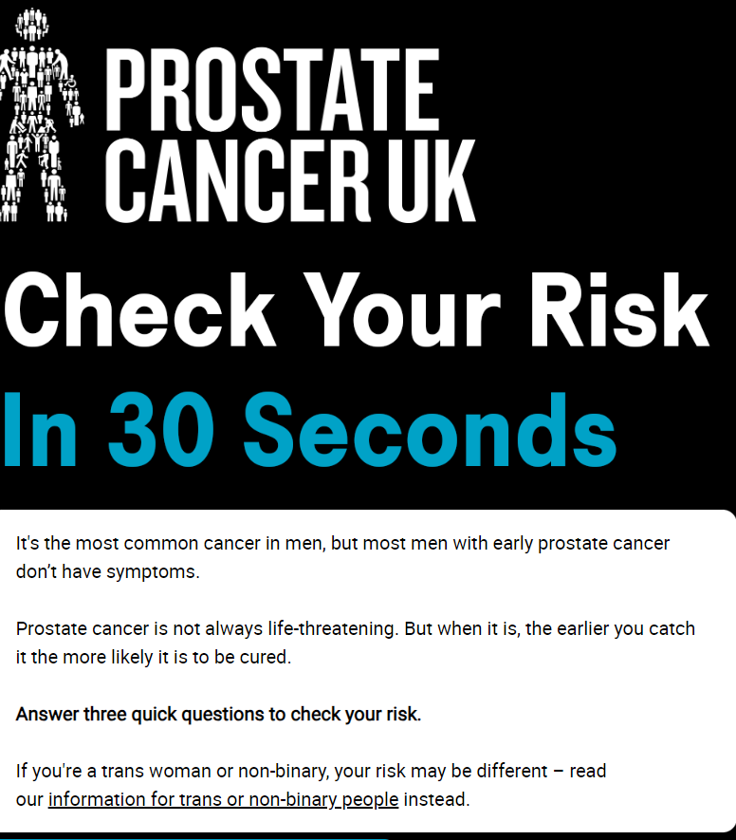
Check your risk
30 second online tool
Information about risk
Balanced & concise information
PSA blood test
87% informed decision
1.8 million views

Slide 7
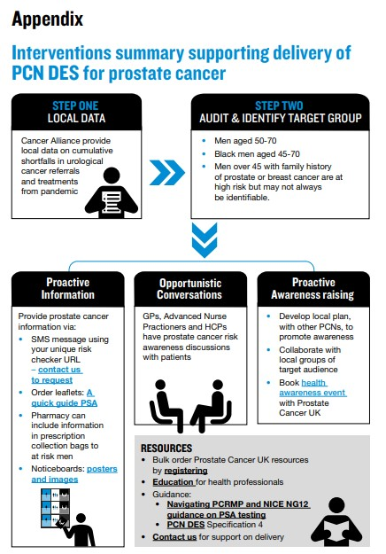
Primary care network – directed enhanced service (PCN-DES)
England
NHS endorsed resource
Straight to test texting project
1. Audit
2. Exclusions
3. SNOMED
Text patient x 3
Risk checker
Informed choice

Slide 8
Straight to test pathway
Benefits
Targeting all men at risk
Increasing awareness of risk
NHS trusted
Efficient pathway
Reduce delays to diagnosis
Workload manageable
Patients perceptions and responses were positive
Sustainable approach ​

Slide 9
Q&A
Thank you for listening
Notes:
Questions?

